Slide 1
http://www.vidyanidhi.com/
ketkiacharya.net@gmail.com
Ketki Acharya
From: SM VITA ATC of CDAC
9769201036
ketkiacharya.net@gmail.com

Slide 2
Event loop: microtasks and macrotasks
The event loop concept is very simple. There’s an endless loop, where the JavaScript engine waits for tasks, executes them and then sleeps, waiting for more tasks.
The general algorithm of the engine:
While there are tasks:
execute them, starting with the oldest task.
Sleep until a task appears, then go to 1.
That’s a formalization for what we see when browsing a page. The JavaScript engine does nothing most of the time, it only runs if a script/handler/event activates.
Examples of tasks:
When an external script <script src="..."> loads, the task is to execute it.
When a user moves their mouse, the task is to dispatch mousemove event and execute handlers.
When the time is due for a scheduled setTimeout, the task is to run its callback.
…and so on.

Slide 3
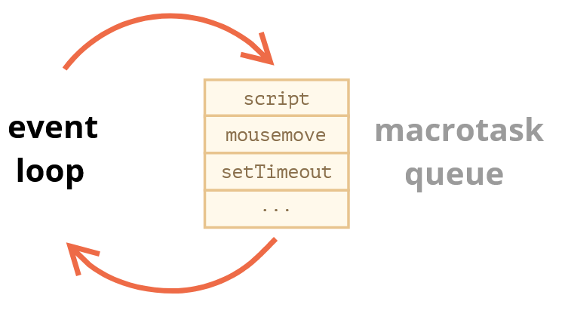
Tasks are set – the engine handles them – then waits for more tasks (while sleeping and consuming close to zero CPU).
It may happen that a task comes while the engine is busy, then it’s enqueued.
The tasks form a queue, so-called “macrotask queue” (v8 term):
For instance, while the engine is busy executing a script, a user may move their mouse causing mousemove, and setTimeout may be due and so on, these tasks form a queue, as illustrated on the picture.
Tasks from the queue are processed on “first come – first served” basis. When the engine browser is done with the script, it handles mousemove event, then setTimeout handler, and so on.
So far, quite simple, right?
Two more details:
Rendering never happens while the engine executes a task. It doesn’t matter if the task takes a long time. Changes to the DOM are painted only after the task is complete.
If a task takes too long, the browser can’t do other tasks, such as processing user events. So after a time, it raises an alert like “Page Unresponsive”, suggesting killing the task with the whole page. That happens when there are a lot of complex calculations or a programming error leading to an infinite loop.

Slide 4
Use-case 1: splitting CPU-hungry tasks
Let’s say we have a CPU-hungry task.
For example, syntax-highlighting (used to colorize code examples on this page) is quite CPU-heavy. To highlight the code, it performs the analysis, creates many colored elements, adds them to the document – for a large amount of text that takes a lot of time.
While the engine is busy with syntax highlighting, it can’t do other DOM-related stuff, process user events, etc. It may even cause the browser to “hiccup” or even “hang” for a bit, which is unacceptable.
We can avoid problems by splitting the big task into pieces. Highlight first 100 lines, then schedule setTimeout (with zero-delay) for the next 100 lines, and so on.
To demonstrate this approach, for the sake of simplicity, instead of text-highlighting, let’s take a function that counts from 1 to 1000000000.
If you run the code below, the engine will “hang” for some time. For server-side JS that’s clearly noticeable, and if you are running it in-browser, then try to click other buttons on the page – you’ll see that no other events get handled until the counting finishes.
let i = 0;
let start = Date.now();
function count() {
// do a heavy job
for (let j = 0; j < 1e9; j++) {
i++;
}
alert("Done in " + (Date.now() - start) + 'ms');
} count();
The browser may even show a “the script takes too long” warning.

Slide 5
Let’s split the job using nested setTimeout calls:
let i = 0;
let start = Date.now();
function count() {
// do a piece of the heavy job (*)
do {
i++;
} while (i % 1e6 != 0);
if (i == 1e9) {
alert("Done in " + (Date.now() - start) + 'ms');
} else {
setTimeout(count); // schedule the new call (**)
}
}
count();
Now the browser interface is fully functional during the “counting” process.
A single run of count does a part of the job (*), and then re-schedules itself (**) if needed:
First run counts: i=1...1000000.
Second run counts: i=1000001..2000000.
…and so on.
Now, if a new side task (e.g. onclick event) appears while the engine is busy executing part 1, it gets queued and then executes when part 1 finished, before the next part. Periodic returns to the event loop between count executions provide just enough “air” for the JavaScript engine to do something else, to react to other user actions.
The notable thing is that both variants – with and without splitting the job by setTimeout – are comparable in speed. There’s not much difference in the overall counting time.

Slide 6
To make them closer, let’s make an improvement. We’ll move the scheduling to the beginning of the count():
let i = 0;
let start = Date.now();
function count() {
// move the scheduling to the beginning
if (i < 1e9 - 1e6) {
setTimeout(count); // schedule the new call
}
do {
i++;
} while (i % 1e6 != 0);
if (i == 1e9) {
alert("Done in " + (Date.now() - start) + 'ms');
}
}
count();
Now when we start to count() and see that we’ll need to count() more, we schedule that immediately, before doing the job.
If you run it, it’s easy to notice that it takes significantly less time.
Why?
That’s simple: as you remember, there’s the in-browser minimal delay of 4ms for many nested setTimeout calls. Even if we set 0, it’s 4ms (or a bit more). So the earlier we schedule it – the faster it runs.
Finally, we’ve split a CPU-hungry task into parts – now it doesn’t block the user interface. And its overall execution time isn’t much longer.

Slide 7
Use case 2: progress indication
Another benefit of splitting heavy tasks for browser scripts is that we can show progress indication.
As mentioned earlier, changes to DOM are painted only after the currently running task is completed, irrespective of how long it takes.
On one hand, that’s great, because our function may create many elements, add them one-by-one to the document and change their styles – the visitor won’t see any “intermediate”, unfinished state. An important thing, right?
But we also may want to show something during the task, e.g. a progress bar.
If we split the heavy task into pieces using setTimeout, then changes are painted out in-between them.
This looks prettier: <div id="progress"></div><script>
let i = 0;
function count() {//do a piece of the heavy job(*)
do {
i++;
progress.innerHTML = i;
} while (i % 1e3 != 0);
if (i < 1e7) {
setTimeout(count);
}
} count();</script>
Now the <div> shows increasing values of i, a kind of a progress bar.
Here’s the demo, the changes to i won’t show up until the function finishes, so we’ll see only the last value:
<div id="progress"></div>
<script>
function count() {
for (let i = 0; i < 1e6; i++) {
i++;
progress.innerHTML = i;
}
}
count();
</script>

Slide 8
Macrotasks and Microtasks
Microtasks come solely from our code. They are usually created by promises: an execution of .then/catch/finally handler becomes a microtask. Microtasks are used “under the cover” of await as well, as it’s another form of promise handling.
There’s also a special function queueMicrotask(func) that queues func for execution in the microtask queue.
Immediately after every macrotask, the engine executes all tasks from microtask queue, prior to running any other macrotasks or rendering or anything else.
For instance, take a look:
setTimeout(() => alert("timeout"));
Promise.resolve()
.then(() => alert("promise"));
alert("code");
What’s going to be the order here?
code shows first, because it’s a regular synchronous call.
promise shows second, because .then passes through the microtask queue, and runs after the current code.
timeout shows last, because it’s a macrotask.

Slide 9
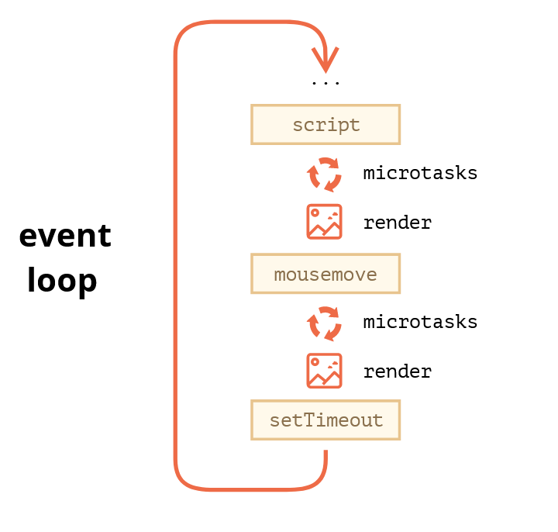
The richer event loop picture looks like this (order is from top to bottom, that is: the script first, then microtasks, rendering and so on):
All microtasks are completed before any other event handling or rendering or any other macrotask takes place.
That’s important, as it guarantees that the application environment is basically the same (no mouse coordinate changes, no new network data, etc) between microtasks.
If we’d like to execute a function asynchronously (after the current code), but before changes are rendered or new events handled, we can schedule it with queueMicrotask.
Here’s an example with “counting progress bar”, similar to the one shown previously, but queueMicrotask is used instead of setTimeout. You can see that it renders at the very end. Just like the synchronous code:

Slide 10
Summary
A more detailed event loop algorithm (though still simplified compared to the specification):
Dequeue and run the oldest task from the macrotask queue (e.g. “script”).
Execute all microtasks:
While the microtask queue is not empty:
Dequeue and run the oldest microtask.
Render changes if any.
If the macrotask queue is empty, wait till a macrotask appears.
Go to step 1.
To schedule a new macrotask:
Use zero delayed setTimeout(f).
That may be used to split a big calculation-heavy task into pieces, for the browser to be able to react to user events and show progress between them.
Also, used in event handlers to schedule an action after the event is fully handled (bubbling done).
To schedule a new microtask
Use queueMicrotask(f).
Also promise handlers go through the microtask queue.
There’s no UI or network event handling between microtasks: they run immediately one after another.
So one may want to queueMicrotask to execute a function asynchronously, but within the environment state.
div id="progress"></div>
<script>
let i = 0;
function count() {
// do a piece of the heavy job (*)
do {
i++;
progress.innerHTML = i;
} while (i % 1e3 != 0);
if (i < 1e6) {
queueMicrotask(count);
}
}
count();
</script>

Slide 11
For long heavy calculations that shouldn’t block the event loop, we can use Web Workers.
That’s a way to run code in another, parallel thread.
Web Workers can exchange messages with the main process, but they have their own variables, and their own event loop.
Web Workers do not have access to DOM, so they are useful, mainly, for calculations, to use multiple CPU cores simultaneously.

Slide 12
Microtasks
Promise handlers .then/.catch/.finally are always asynchronous.
Even when a Promise is immediately resolved, the code on the lines below .then/.catch/.finally will still execute before these handlers.
Here’s a demo:
let promise = Promise.resolve();
promise.then(() => alert("promise done!"));
alert("code finished"); // this alert shows first
If you run it, you see code finished first, and then promise done!.
That’s strange, because the promise is definitely done from the beginning.
Why did the .then trigger afterwards? What’s going on?
Microtasks queue
Asynchronous tasks need proper management. For that, the ECMA standard specifies an internal queue PromiseJobs, more often referred to as the “microtask queue” (V8 term).
As stated in the specification:
The queue is first-in-first-out: tasks enqueued first are run first.
Execution of a task is initiated only when nothing else is running.
Or, to say more simply, when a promise is ready, its .then/catch/finally handlers are put into the queue; they are not executed yet. When the JavaScript engine becomes free from the current code, it takes a task from the queue and executes it.
That’s why “code finished” in the example above shows first.

Slide 13
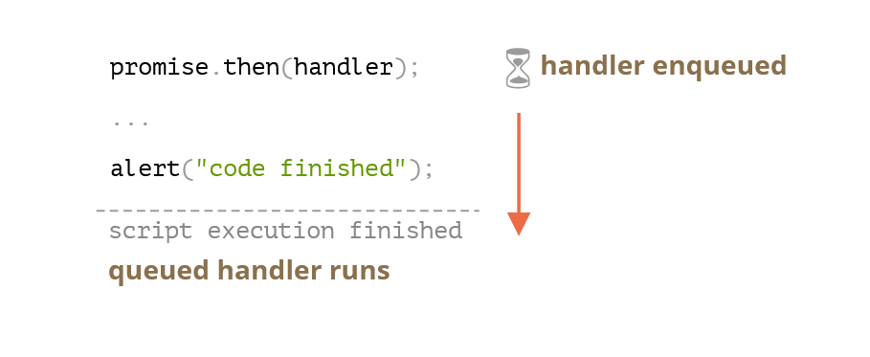
Promise handlers always go through this internal queue.
If there’s a chain with multiple .then/catch/finally, then every one of them is executed asynchronously. That is, it first gets queued, then executed when the current code is complete and previously queued handlers are finished.
What if the order matters for us? How can we make code finished run after promise done?
Easy, just put it into the queue with .then:
promise.resolve()
.then(() => alert("promise done!"))
.then(() => alert("code finished"));
Now the order is as intended.

Slide 14
Unhandled rejection
Remember the unhandledrejection event from the article Error handling with promises?
Now we can see exactly how JavaScript finds out that there was an unhandled rejection.
An “unhandled rejection” occurs when a promise error is not handled at the end of the microtask queue.
Normally, if we expect an error, we add .catch to the promise chain to handle it:
let promise = Promise.reject(new Error("Promise Failed!"));
promise.catch(err => alert('caught'));
// doesn't run: error handled
window.addEventListener('unhandledrejection', event => alert(event.reason));

Slide 15
But if we forget to add .catch, then, after the microtask queue is empty, the engine triggers the event:
let promise = Promise.reject(new Error("Promise Failed!"));
// Promise Failed!
window.addEventListener('unhandledrejection', event => alert(event.reason));
What if we handle the error later? Like this:
let promise = Promise.reject(new Error("Promise Failed!"));
setTimeout(() => promise.catch(err => alert('caught')), 1000);
// Error: Promise Failed!
window.addEventListener('unhandledrejection', event => alert(event.reason));
Now, if we run it, we’ll see Promise Failed! first and then caught.
If we didn’t know about the microtasks queue, we could wonder: “Why did unhandledrejection handler run? We did catch and handle the error!”
But now we understand that unhandledrejection is generated when the microtask queue is complete: the engine examines promises and, if any of them is in the “rejected” state, then the event triggers.
In the example above, .catch added by setTimeout also triggers. But it does so later, after unhandledrejection has already occurred, so it doesn’t change anything.

Slide 16
Promise handling is always asynchronous, as all promise actions pass through the internal “promise jobs” queue, also called “microtask queue” (V8 term).
So .then/catch/finally handlers are always called after the current code is finished.
If we need to guarantee that a piece of code is executed after .then/catch/finally, we can add it into a chained .then call.
In most Javascript engines, including browsers and Node.js, the concept of microtasks is closely tied with the “event loop” and “macrotasks”.

